Slide 1
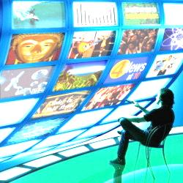
The Media Industry
Media 101

Slide 2
In this presentation…
What is media?
Why is it important?
What is content?
What are the different types of content?
What are the different media channels?
What are the different media types?
What are the current consumption patterns w.r.t these media channels?
What are the common segments within M&E?
What are the common revenue models?
Who are the stakeholders?
What does Cybage do in Media and Entertainment?

Slide 3


What is Media?
Media is a collective term used as a tool/channel/conduit used to store and deliver information or data
Medium (singular form) is derived from the Latin word medius meaning middle.
Media helps connect the sender and receiver
It helps overcome the constraints of face to face communication, distance and time
MESSAGE RECEIVED
TRANSMIT MESSAGE
RECEIVER
RECEIVER DECODES MESSAGE
TRANSMITTER ENCODES MESSAGE
START WITH A MESSAGE
SENDER
Media not only bridges the gap between sender and receiver (one to one),
but also enables broadcasting of messages (one to many)…

Slide 4


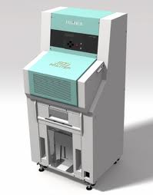
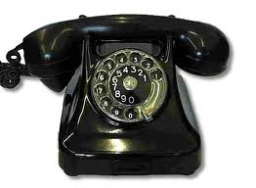


What is Media?
Evolution of Communication Channels
INTERNET
BROADCAST
PRINT
REACH
PHONE
LETTERS
FACE
TO FACE
TIME
Over the years, various channels have
allowed communication on a near global scale!

Slide 5
Why is Media Important?
Media is important to us
COMMUNICATION
SHARING INFORMATION
SOCIAL GRATIFICATION
NEWS
BUSINESS COMMUNICATION
ENTERTAINMENT
POLITICS
EDUCATION & KNOWLEDGE
INTERACT WITH INFLUENCERS
All of us play the roles of sender and receivers,
and media addresses our need to communicate and assimilate…

Slide 6

What is Content?
Media is the channel, Content is the message that flows through it
Message is:
Any thought or idea expressed in a language, prepared in a form suitable for transmission by any means of communication
An arbitrary amount of information whose beginning and end are defined or implied
Content could be one central message, or a mix of multiple messages or both
For example, the central message of this presentation is to make the audience understand the media industry better. The smaller messages are centered on the importance of communication, messaging and content within the industry – these are inter related.
Messages are contextual, situational and need based.
They need are tailored for audiences…

Slide 7
What are the Different Types of Content?
Content can be categorized in different ways based on context & access
BBC, CRICINFO
INDIA TODAY, TIMES OF INDIA
GOVERNMENT ANNOUNCEMENTS
FREEMIUM
INFORMATIVE
Public service content
(1 way)
Advertising
Promoted content
(1 way)
HYBRID
Advertising
+ Paid content
(1 way)
SOCIAL
INFORMATION
Based on personal relationships
(2 way)
Paid access content
(1 way)
FACEBOOK, TWITTER
NIELSEN, GARTNER
Social content tends to have two-way communication;
Business content often has one way communication…

Slide 8
What are the Different Types of Media Channels?
Media Channels can be categorized in multiple ways
HANDHELD DEVICES
CONSOLES
STREAMING ON DEMAND
eCONTENT
SOCIAL NETWORKS
MESSAGE BOARDS/FORUMS
EMERGING
PRINT CONTENT (magazines, newspapers, books, etc.)
THEATRE/MOVIES
MANUAL TYPESETTED PRINT
TELEVISION
RADIO (TERRESTIAL AND SATELLITE)
BROADCAST & PRINT
WRITING
FACE TO FACE
TELEPHONES
INSTANT MESSENGERS
INTIMATE
LOW
MEDIUM
HIGH

Slide 9
What are the Different Types of Media?
Owned, Paid and Earned
Type | Definition | Examples | Role | Benfits | Challenges
OWNED | Channel brand controls | Web site Mobile site Blog Twitter Account | Build for longer-term relationships with existing potential customers and earned Media | Control Cost efficiency Longevity Versatility Niche Audiences | No guarantees Company communication not trusted Takes time to scale
PAID | Brand pays to leverage a channel | Display ads Paid search Sponsorships | Shift from foundation to a catalyst that feeds owned and creates earned media | In demand Immediacy Scale Control | Clutter Declining response rates Poor credibility
EARNED | When customers become the channel | WOM Buzz “Viral” | Listen and respond — earned media is often the result of well executed and well coordinated owned and paid media | Most credible Key role in most sales Transparent and lives on | No control Can be negative Scale Hard to measure

Slide 10
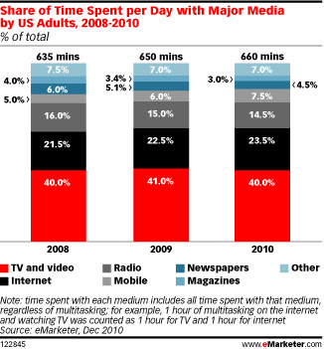
What are the current consumption patterns?
TV and video still rank strong but…
Internet and mobile is the next big thing…and the shift has already begun!

Slide 11
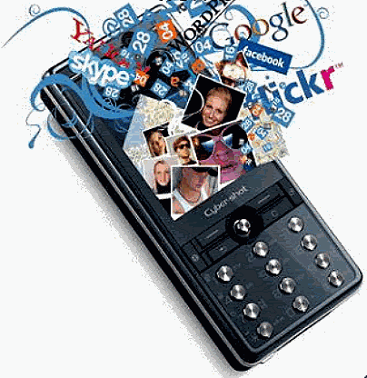
What are the current consumption patterns?
Aggressive adoption of internet and mobile is underway
Internet
Content is gradually but surely becoming ‘Web’ exclusive
Examples include e-books, streaming, etc.
Impact on traditional media
Newspapers and radio industries are fast transitioning out of legacy operations and embracing digital business models
Broadcast television is embracing digital videos and streaming
Magazines that are photo ‘heavy’ thrive, rest have started shifting to e-zines
Mobile
Rise in consumer devices has led to the rise of mobile and handheld economies
Consumption of content has transcended the PC
Emerging media will soon become media

Slide 12
What are the common segments within M&E?
Networks, Exchanges, Agencies, etc.
ADVERTISING
Websites, Portals, etc.
ONLINE CONTENT
PUBLISHING
Academic, Magazine, Newspaper, etc.
M&E
ENTERTAINMENT and EVENTS
GAMING
Theatres, Concerts, etc.
Console, PC, Web, Social, etc.
ON DEMAND CONTENT
BROADCAST MEDIA
Streaming content as provided by NetFlix, Spotify, etc.
Television, Radio
Each segment operates on broadly the same model,
but the specifics change

Slide 13
What are the Common Revenue Models?
Advertising and Subscriptions
Rise of digital content is leading to traditional content producers incorporating newer models
There is no such thing as a ‘free lunch’
Free access is often advertising driven
Advertising models consist of various models that are action or impression dependent
Cost per mille (impressions)
Cost per sale
Cost per action
Cost per click
By Channels | SUBSCRIPTIONS |  |  |  | ADV.
 | Free | On Demand | Title | Time based
SOCIAL NETWORKS | ✓ | ✗ | ✗ | ✓ | ✓
STREAMING ON DEMAND | ✓ | ✓ | ✓ | ✓ | ✓
eCONTENT | ✓ | ✓ | ✓ | ✓ | ✓
TELEVISION RADIO | ✓ | ✓ | ✗ | ✓ | ✓
PRINT CONTENT –B2B | ✓ | ✓ | ✓ | ✓ | ✓
PRINT CONTENT –B2C | ✓ | ✗ | ✓ | ✓ | ✓
THEATRE/MOVIES/GAMES | ✗ | ✗ | ✓ | ✗ | ✓

Slide 14
Who are the Stakeholders?
The Value Chain
Publishers could include content syndicators/aggregators as well…

Slide 15






Who are the Stakeholders?
The Value Chain
Big Spenders
P&G, AT&T, Pfizer, GM, News Corp, Johnson & Johnson, GE
P&G spend – USD 2.25 b
Big ISVs
Apple, Amazon, Google, RR Donnelly
These companies provide B2B services
Big Publishers
Demand Media, News Corp, Gannett, Google, AOL, Microsoft, Warner Bros, Sony, Universal, Reed Elsevier, Yahoo
Often the biggest publishers are media conglomerates spanning multimedia content
Big Planners
Omnicom Group, WPP, Interpublic, Publicis Groupe, Dentsu, Havas
Omnicom Revenue – USD 12.5 b
Big Exchanges
24x7 RealMedia, DoubleClick, Yahoo
Large exchanges that provide technology platforms to publishers and advertisers
Big Content Syndicators
YouTube, Netflix, Spotify, Factiva, Lexis Nexis
Content syndicators license content and aggregate it for use by consumers

Slide 16

What is Cybage’s Contribution?
The Clientele
TECHNOLOGY SERVICES
Digital
iCrossing, iProspect
Traditional
GroupM
MediaMorph
Ooyala
Demand Media
Washington Post
Wolters Kluwer
LexisNexis
TidalTV
Google DoubleClick
Cybage’s M&E team consists of 600 engineers servicing over 50 clients!

Slide 17

What is Cybage’s Contribution?
Services Provided
Product Development & Maintenance
QA
Enterprise/Consumer App Development
Managed Services
Creative Design
Technical Support
Documentation
Cybage has been ranked among the Top 10 Global Leader for the
Media & Entertainment Industry by IAOP

Slide 18
Thank You !
Presented by
Rakesh Ramchandani
rakeshr@cybage.com

